Slide 1

Airbnb’s in New York City
PRESENTER: ROY JOANNIDES
PROJECT 1
DATE: 8-03-2024

Slide 2

PROJECT OUTLINE
Project Overview
Data Wrangling and Cleaning
Exploratory Data Analysis
Major Obstacle
Conclusion and Insights

Slide 3

Project Overview
Since 2008, guests and hosts have used Airbnb to expand on traveling possibilities and present more unique, personalized way of experiencing the world.
This project aims to analyze the New York City Airbnb dataset (2019) to uncover insights into listing characteristics, pricing patterns, and host popularity.

Slide 4

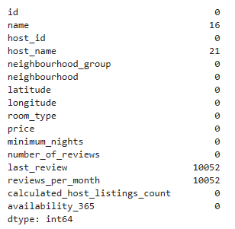
Project Overview
Data:
The dataset is sourced from Kaggle
Public dataset from - website
The data is a mix between categorical and numeric values.
The file includes data about hosts, geographical availability, room types and customer review dates
This dataset has about 48895 entries with 16 columns.
Sum of null values: 20141

Slide 5

Project Overview
Hypothesis 1: The neighborhood group significantly influences the price and number of Airbnb listings
Hypothesis 2: Particular room types are more popular and demand higher prices.
Hypothesis 3: Having higher listings has a positive correlation with a higher host popularity index (number of reviews)

Slide 6
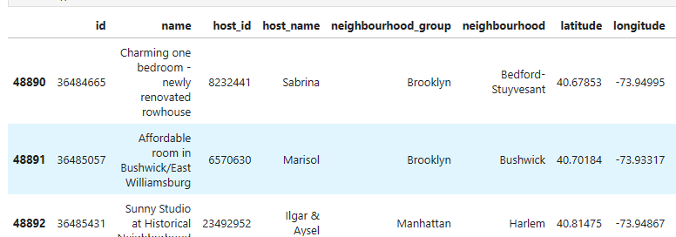
Cleaning & Wrangling
The ‘name’ column was dropped because it was not relevant for the analysis.
The ‘host_name’ column was similarly dropped. There was a corresponding ‘host_ID’ column which served the same purpose and contained more unique values (37457), as against (11452) for ‘host_name’.
In geo-ethics, it is considered best practice to anonymize names of persons during data analysis for privacy and safety reasons.
Notes:
Additionally, there was a corresponding ‘ID’ column which served the same purpose. it would have been redundant to keep both.

Slide 7
Cleaning & Wrangling
The null values of ‘reviews_per_month’ were filled with the mean of values in this column. Providing a representative and unbiased estimate.
The ‘availability_365’ column was renamed to ‘yearly_availability_365’. “yearly_availability_365” is more descriptive & intuitive for all readers regardless of their affinity with the dataset.
Notes:
minimizing the impact of missing values on the distribution of this columns data which are used in the analysis.

Slide 8

Analysis and Visualizations

Slide 9
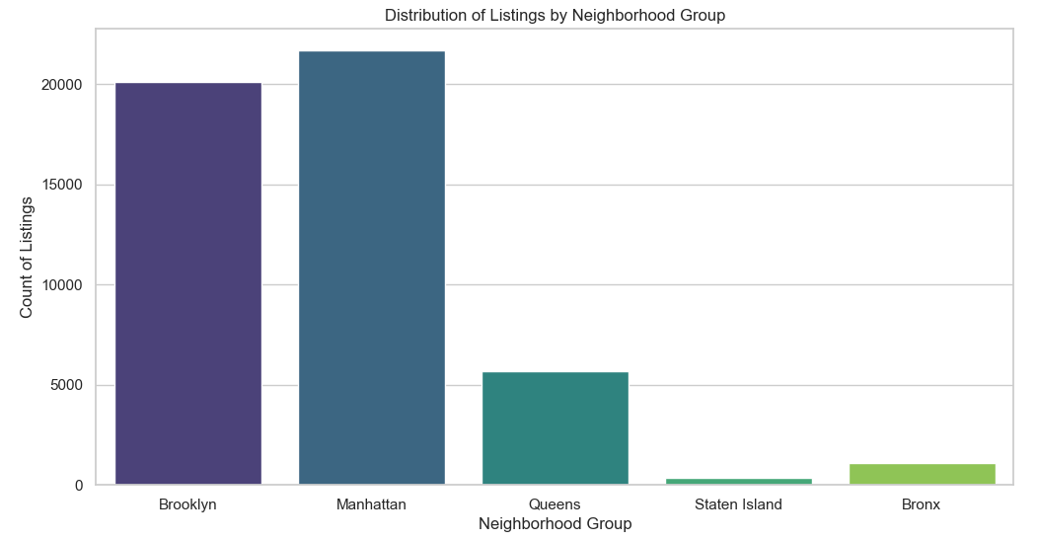
H1: The neighborhood group significantly influences the number of Airbnb listings

Slide 10
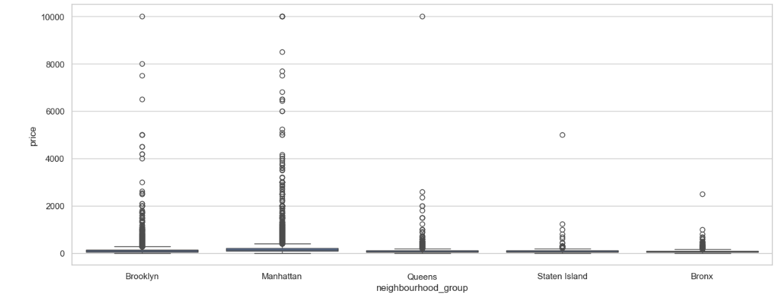
H1: The neighborhood group significantly influences the price of Airbnb listings

Slide 11
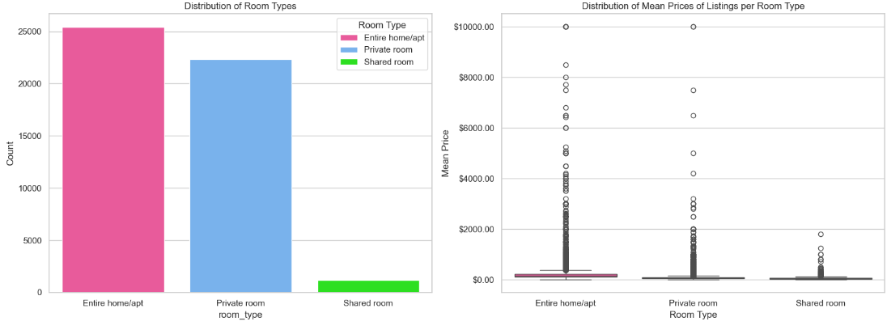
H2: Particular room types are more popular and demand higher prices.

Slide 12
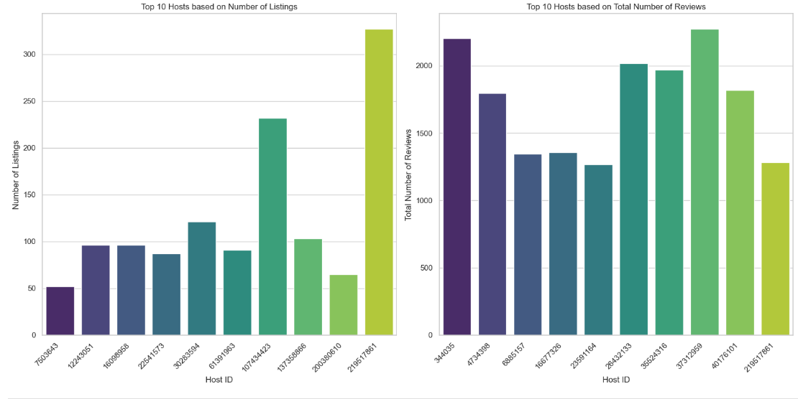
H3: Having higher listings has a positive correlation with a higher host popularity index (number of reviews).

Slide 13
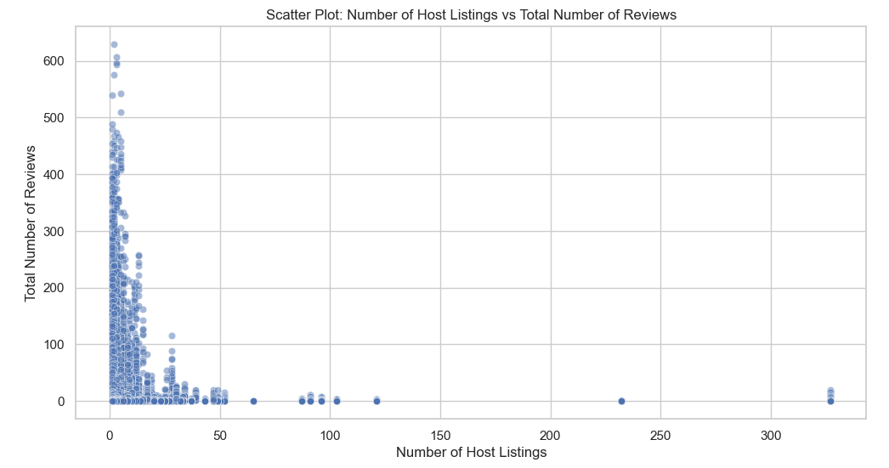
H3: Having higher listings has a positive correlation with a higher host popularity index (number of reviews).

Slide 14
Major Obstacle
For further analysis, it would have been nice to have additional columns such as a customer review column scored by a likert scale system (for eg: 0-5) for each listing.
This would have for example facilitated bivariate analysis on the satisfaction of customers for each listing.

Slide 15
Conclusions
Neighborhood groups indeed have a notable impact on listing numbers and prices
Certain room types are more popular, and they often attract higher prices
There is no strong linear relationship between the number of host listings and the total number of reviews. Hosts with more listings do not necessarily receive more reviews, or vice versa.
Notes:
H1: Certain areas command higher prices than others, potentially due to location or demand. Subsequently, we analysed the relationship between the different room types and prices.
h3- -0.072 correlation

Slide 16
Conclusions
Identify and promote popular room types to attract more guests and increase overall occupancy which translates into revenue
Identify and promote listings in low performing geographic clusters (e.g, the Bronx), focusing marketing efforts and optimizing pricing strategies to decentralize population settlement across the city
Optimize listing promotion strategies to enhance the visibility and popularity of diverse hosts, irrespective of the number of listings

Slide 17

Thank You

